Slide 1
Network Layer

Slide 2
Introduction
The network layer is concerned with getting packets from the source all the way to the destination. [hops]
The data link layer has modest goal of just moving frames from one end of a wire to the other.
Network layer is the lowest layer that deals with end-to-end transmission.
Choosing appropriate path. [routing]

Slide 3
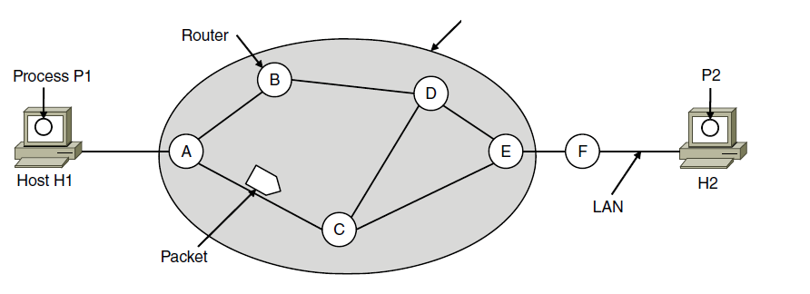
Network Layer Design Issues service to TL and internal design
Store-&-forward Pkt s/w:

Slide 4
Service Provided to the Transport Layer:
The services need to be carefully designed with the following goals in mind:
1. The services should be independent of the router technology.
2. The transport layer should be shielded from the number, type, and topology of the routers present.
3. The network addresses made available to the transport layer should use a uniform numbering plan, even across LANs and WANs.

Slide 5
The network layer should provide connection-oriented service or connection-less service.
One champ (Internet): Connectionless
Router job is to just to move pkts; n/w is unreliable; host should do error and flow control.
Other champ (Telephone): Connection-Or
Reliable; QoS is dominant factor -> real-time traffic such as voice and video.
Notes:
ARPNET IP: Coless
X.5 FR ATM MPLS: CO

Slide 6
If connectionless service is offered, packets are injected into the network individually and routed independently of each other. No advance setup is needed. In this context, the packets are frequently called datagrams (in analogy with telegrams) and the network is called a datagram network.
If connection-oriented service is used, a path from the source router all the way to the destination router must be established before any data packets can be sent. This connection is called a VC (virtual circuit), in analogy with the physical circuits set up by the telephone system, and the network is called a virtual-circuit network

Slide 7
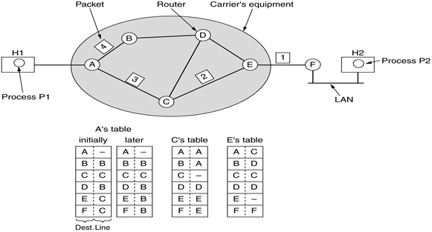
Implementation of Connectionless Service

Slide 8
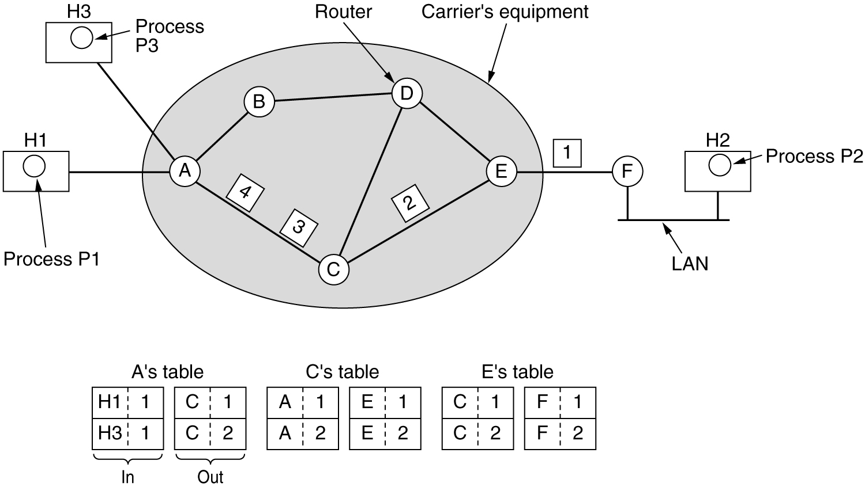
Implementation of Connection-Or Service

Slide 9
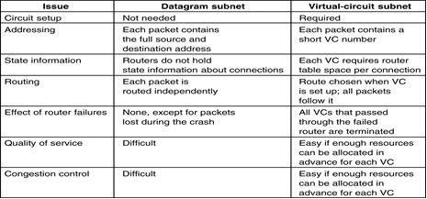
Comparison

Slide 10
Routing
The main function of the network layer is routing packets from the source machine to the destination machine.
The routing algorithm is that part of the network layer software responsible for deciding which output line an incoming packet should be transmitted on.
If the network uses datagrams internally, this decision must be made anew for every arriving data packet since the best route may have changed since last time.
If the network uses virtual circuits internally, routing decisions are made only when a new virtual circuit is being set up. Thereafter, data packets just follow the already established route. The latter case is sometimes called session routing because a route remains in force for an entire session (e.g., while logged in over a VPN).

Slide 11
It is sometimes useful to make a distinction between routing, which is making the decision which routes to use, and forwarding, which is what happens when a packet arrives.
One can think of a router as having two processes inside it.
One of them handles each packet as it arrives, looking up the outgoing line to use for it in the routing tables. This process is forwarding.
The other process is responsible for filling in and updating the routing tables. That is where the routing algorithm comes into play.

Slide 12
Regardless of whether routes are chosen independently for each packet sent or only when new connections are established, certain properties are desirable in a routing algorithm:
correctness, simplicity, robustness, stability, fairness, and efficiency.

Slide 13
Nonadaptive and Adaptive Routing Algo
Nonadaptive algorithms do not base their routing decisions on any measurements or estimates of the current topology and traffic. Instead, the choice of the route to use to get from I to J is computed in advance, offline, and downloaded to the routers when the network is booted. This procedure is sometimes called static routing. Because it does not respond to failures, static routing is mostly useful for situations in which the routing choice is clear.

Slide 14
Adaptive algorithms, in contrast, change their routing decisions to reflect changes in the topology, and sometimes changes in the traffic as well.
These dynamic routing algorithms differ in
where they get their information (e.g., locally, from adjacent routers, or from all routers),
when they change the routes (e.g., when the topology changes, or every ΔT seconds as the load changes), and
what metric is used for optimization (e.g., distance, number of hops, or estimated transit time).

Slide 15
The Optimality Principle(Bellman, 1957)
It states that if router J is on the optimal path from router I to router K, then the optimal path from J to K also falls along the same route.
As a direct consequence of the optimality principle, we can see that the set of optimal routes from all sources to a given destination form a tree rooted at the destination. Such a tree is called a sink tree and is illustrated in Fig. (where the distance metric is the number of hops. )
Notes:
Routing: topology
Traffic-> cong control

Slide 16
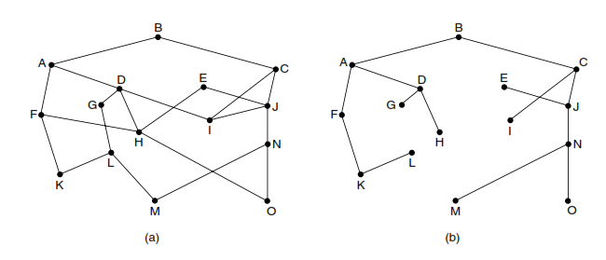

Slide 17
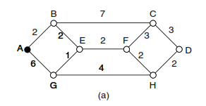
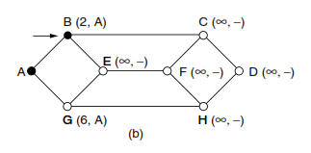
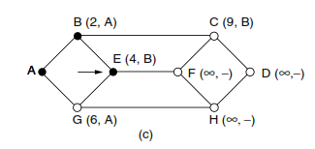
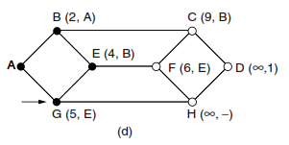
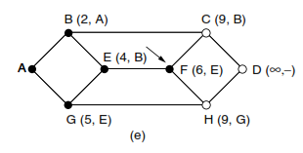
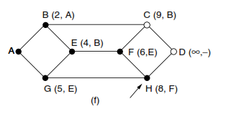
Shortest Path Algo

Slide 18
Flooding
When a routing algorithm is implemented, each router must make decisions based on local knowledge, not the complete picture of the network. A simple local technique is flooding, in which every incoming packet is sent out on every outgoing line except the one it arrived on.

Slide 19
Distance Vector Routing
Computer networks generally use dynamic routing algorithms that are more complex than flooding, but more efficient because they find shortest paths for the current topology.
Static algo do not take the current n/w load into account.
Two dynamic algorithms in particular, distance vector routing and link state routing, are the most popular.

Slide 20
A distance vector routing (distributed Bellman-Ford) algorithm operates by having each router maintain a table (i.e., a vector) giving the best known distance to each destination and which link to use to get there. These tables are updated by exchanging information with the neighbours. Eventually, every router knows the best link to reach each destination.

Slide 21
In distance vector routing, each router maintains a routing table indexed by, and containing one entry for each router in the network.
This entry has two parts:
the preferred outgoing line to use for that destination and
an estimate of the distance to that destination.
The distance might be measured as the number of hops or using another metric, as we discussed for computing shortest paths.

Slide 22
Principle: Each router periodically shares its knowledge about neighbors or internetworks with its neighbors only.
It receives information from directly attached neighbors only.

Slide 23
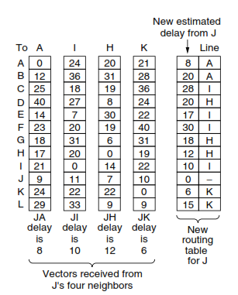
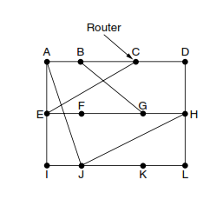
Example from Tanenbaum

Slide 24
Example from Forouzan
Bellman ford and Distance vector

Slide 25
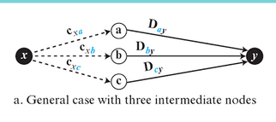
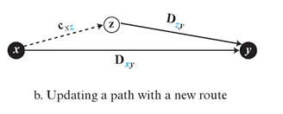

Slide 26
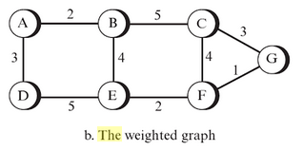
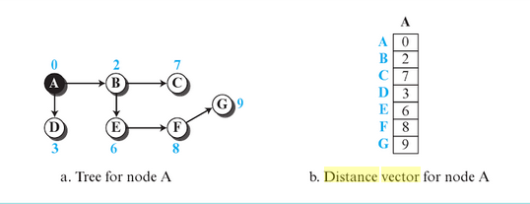

Slide 27
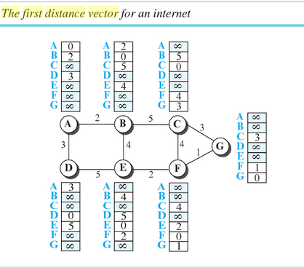

Slide 28

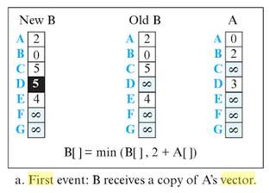
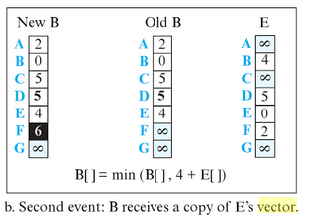


Slide 29
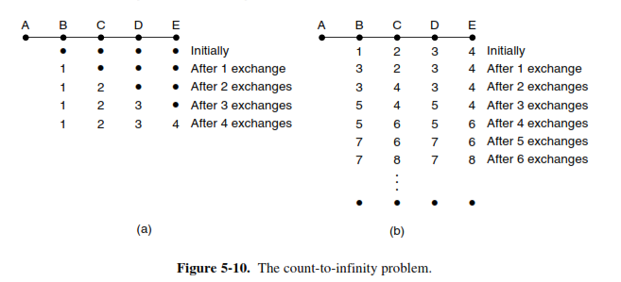

Slide 30
Characteristics of Algorithms
Distributed: as it receives and send back information to neighbors
Iterative: it updates table periodically
Asynchronous: all routers need be updated at the same time

Slide 31
Link State Routing
Distance vector routing was used in the ARPANET until 1979, when it was replaced by link state routing. The primary problem that caused its demise was that the algorithm often took too long to converge after the network topology changed (due to the count-to-infinity problem). Consequently, it was replaced by an entirely new algorithm, now called link state routing.

Slide 32
Link State Routing Algorithm
Distance : delay(time) or Traffic or security
Principle: Each router shares it information with all the routers in the networks.
Algorithm:
Discover the neighbor and learn network address
Measure the delay or cost
Construct link state packet
Send it to all routers in network
Compute shortest distance path for all routers using Dijkstra’s algorithm

Slide 33
Step –I: Sends a special hello packet on each point to point line and get the information about network address.
Step-II: Sends the echo packet to neighbors and calculate the delay by RTT/2
Step-III: Construct the link state packet for each router
Step-IV: Each router sends it link state packet to all and hence all router will have same link state database
State V: Apply Dijkstra’s algorithm to find shortest path tree for each router

Slide 34
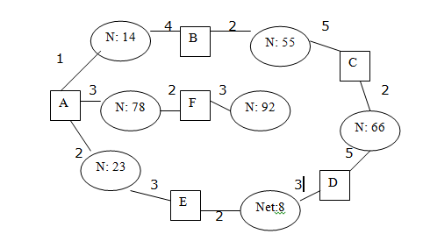
Note A To B cost is 01 and B To A cost is 04
Router | Network ID | Cost | Neighbor
A | 14 | 1 | B
A | 78 | 3 | F
A | 23 | 2 | E
B | 14 | 4 | A
B | 55 | 2 | C
C | 55 | 5 | B
C | 56 | 2 | D
D | 66 | 5 | C
D | 08 | 3 | E
E | 23 | 3 | A
E | 08 | 2 | D
F | 78 | 2 | A
F | 92 | 3 | -

Slide 35
Finding Routing table for A using Dijkstra’s algorithm

Slide 36
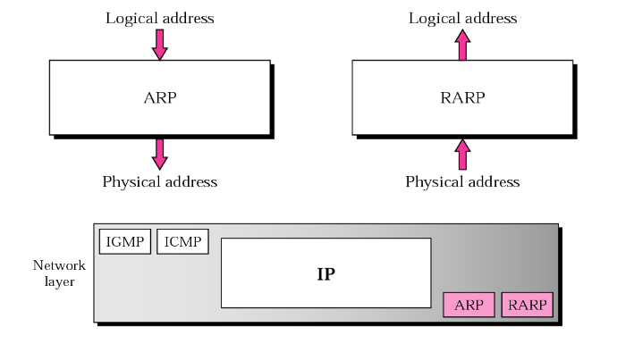
ARP and RARP

Slide 37
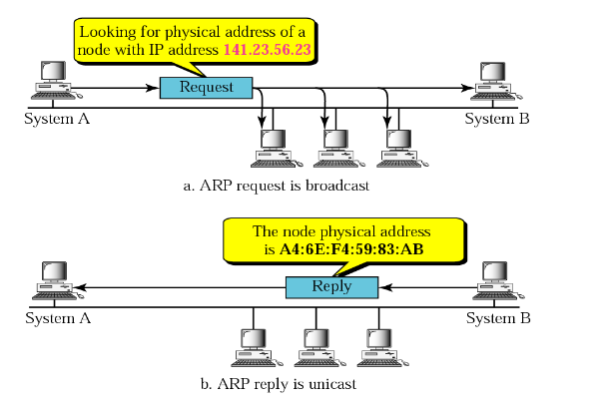
Operation

Slide 38
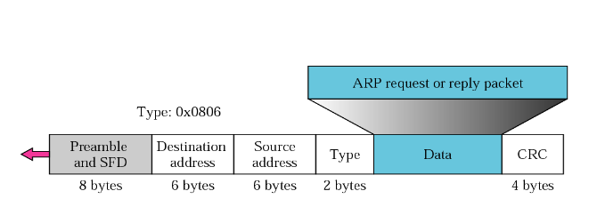

Slide 39
RARP
RARP finds the logical address for a machine that only knows its physical address
The RARP request packets are broadcast; the RARP reply packets are unicast.

Slide 40
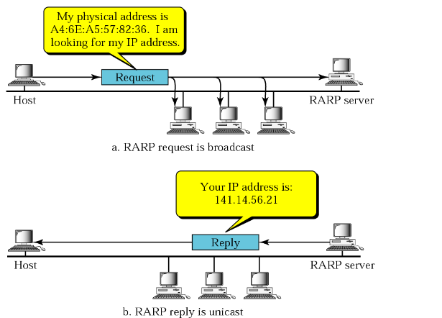
Alternative solution to RARP
BOOTP
DHCP

Slide 42
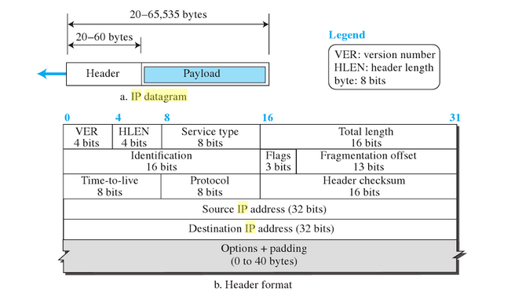
IPv4

Slide 43
Packet Size: 64 K
IP packet of size 1400 bytes is to be transferred over a link layer whose MTU is 1000 bytes. What will be values of fragment, Offset and Flag related to fragmentation for all the fragments produced.
[1][0][1],
[2][1000][0],

